Slide 1

Guiding Principles
Introduction
Design and Analysis of Algorithms I

Slide 2
Guiding Principle #1

Slide 3
Guiding Principle #2

Slide 4
Guiding Principle #3

Slide 5
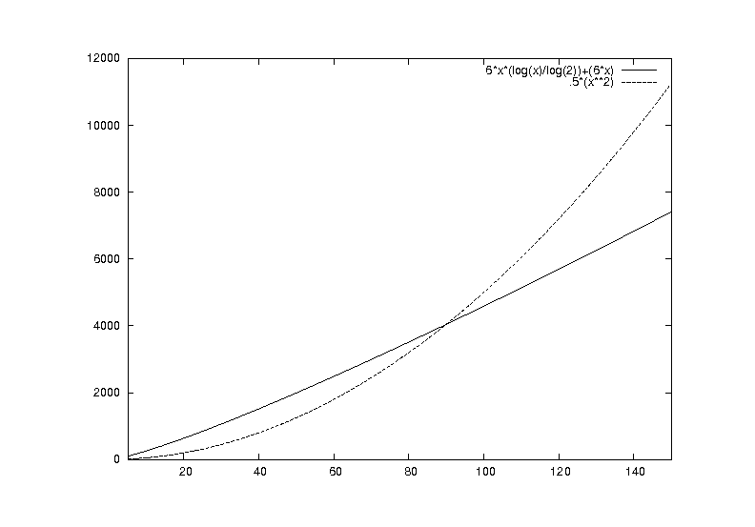

Slide 6
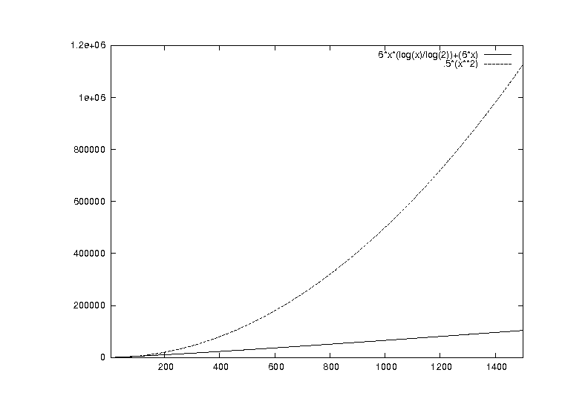

Slide 7
What Is a “Fast” Algorithm?

